Slide 2
It is just a tool!

Slide 3
Meeting Goals
For everyone to walk out with at least one tech integration idea, tool or strategy to use in their classroom.
Explore the DE Board Builder tool.
Share implementation ideas and success stories.
Lessons learned.

Slide 4
SAMR Model
Framework to help teachers identify that technology integration is improving not just replacing practices.

Slide 6
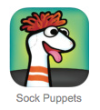
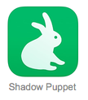
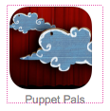
Digital Storytelling
Students combine text, media and audio to tell stories in creative and engaging ways.
Variety of tools to help you plan, create and publish stories.

Slide 8
Sample Activity
Write a story using a note taking App like Paper Desk.
Define characters and actions
Practice reading the story
Use the App of your choice to record the project.

Slide 9
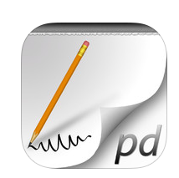
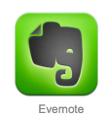
Productivity
Paper Desk

Slide 10
Image Based Story Project
Choose your shots
Tell your story
Select your music
Enjoy your video

Slide 11
Presentations and Videos
Haiku Deck
Animoto

Slide 13
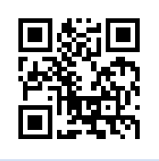
QR (Quick Response) Codes
The codes act as hyperlinks
to data and other resources
for use by students.
Create codes:
www.qrstuff.com

Slide 14
DE Quick Facts
All students at SLS have a unique login to access DE products from school or from home.
SLS subscribes to the following products:
Streaming Plus
Science Elementary and Science Middle School
MS Science Techbook
MS Social Studies Techbook

Slide 16
Blogs to follow
Rychard Byrne’s Free Technology for Teachers
http://www.freetech4teachers.com/
Wes Fryer’s Moving at the Speed of Creativity
http://www.speedofcreativity.org/

